Slide 1



#Where Should I Live?
Using APIs, Matplotlib and Pandas to determine the best place to live
Portia Essuman, Reema Singh, Serena Terry, Andy Watson, Elisa White

Slide 2


Back Story
According to a study conducted by the United States Census Bureau, the average person moves 11.7 times throughout their life.¹
35.5 million Americans move each year.²
Roughly 90,000 people moved to Metro Atlanta between 2016 and 2017.³
¹https://www.packonthego.com/how-many-times-does-the-average-person-move/
²https://www.move.org/moving-stats-facts/
³https://atlanta.curbed.com/2018/3/23/17154866/atlanta-fastest-growing-metro-area-in-us-country

Slide 3
Back Story – Reasons for Moving
Relocate to a new or better home
Family Reasons
Cheaper Housing
Move to a safer neighborhood
Establish one’s own household
New Job or Job Transfer
Transitioning from renting to owning
Schools
¹https://www.move.org/moving-stats-facts/

Slide 4
Back Story – Important Factors when Deciding Where to live
Affordability
Education System
Culture
Food Options
Commute Time and Public Transportation Options
Crime Rates and Statistics
Proximity to Family and Friends
¹https://www.moneycrashers.com/where-should-i-live-decide-best-places/

Slide 5

Create an application that predicts the best place for a user to move based on the user’s preferences.

Slide 6
Hypotheses
Zip Codes with higher neighborhood rankings will have higher home values
Zip Codes with lower school rankings will have lower home values

Slide 7


Methodology - APIs
The following APIs were used to collect data
ATTOM (Pricing)
Google Maps Nearby Places (Neighborhood Information)
Schooldigger.com (School Data)
Zip Code API (Data by Zip Code)
Developer.Here.com*
Walkscore.com*
Zillow.com*
* API Keys were created, but data was not used from these sources in the final code.

Slide 8

Methodology – Data Cleansing
As part of data cleansing we…
1.) Characterized the nature of the fields
Is it character data (e.g., name and address), logical, or numeric?
If numeric, is it integer or floating point?
2.) Uncover and address two potential problems with raw data:
Outliers and Missing Values
Outliers are observations that are far from the bulk of the data
Missing Values can be recoded 0, recoded to a data value
typically the mean of the field or removed from the data set (not recommended)
(e.g., 99999 code is an error from API key for zip codes and was removed from data.)

Slide 9

Methodology – Data Cleansing continued…
3.) Identify potential aggregations of data that will be useful in modeling process.
4.) Explore Data to uncover patterns and relationships in observations
a.) Can provide insight into previously unknown relationships between features
b.) Determines whether goal of modeling project is achievable
“A critical feature of success at this stage is the data science team’s capability to rapidly iterate both in data manipulations and generation of model prototypes. By necessity, data exploration involves experimentation by the modeler.”

Slide 10
Methodology - Limitations
Limited results returned per API call
Google Maps Nearby Places
Schooldigger Limits
API Call Maxed Out
Location types are determined by the data source
Ratings based on “counts” for locations API
Coordinates vs Zip Codes (Google’s API based on coordinates)

Slide 11




How it Works
1.) User provides a city, zip code or address for app
2.) App returns zip codes within a specified distance from city
3.) Zip codes are then ranked on the following criteria:
Places of Interest
School System
Walkability
Crime
Price

Slide 12
Methodology - Ranking
Step 1: Establish a Common Ground for Comparison
What are the figures / numbers / parameters that can be used as a baseline
Step 2: Compare every individual parameter with the average of the parameter to get a score.
Criteria | Ranking Score
X >= 125% of Average | 10
X = Average | 7.5
50% Average < X <= 99% Averge | 5
0% Average < X <= 49% Average | 1
0 = X | 0

Slide 13
School API Conclusion

Slide 14
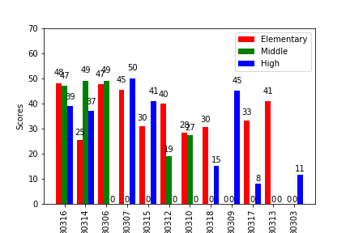
Results from School API
School Ratings by Type for each Zip Code
This graph shows the ratings of school types present in each zip code.

Slide 15
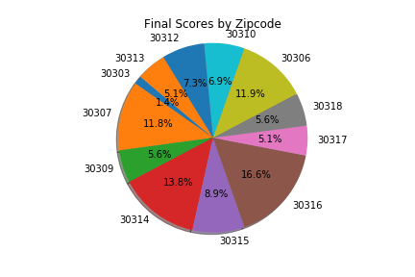
Results from School API
Final Schools Ratings by Zip Code
If school district is your most important criteria, we recommend moving to zip code 30316.
Zip Code 30314 is rated second
Zip Code 30306 is rated third
Zip Code 30307 is rated fourth

Slide 16
Neighborhood API Results

Slide 17
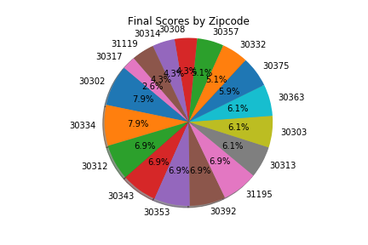
Results from Neighborhood
If neighborhood is your most important criteria, we recommend moving to zip codes 30302 and 30334.

Slide 18
Price API Results

Slide 19
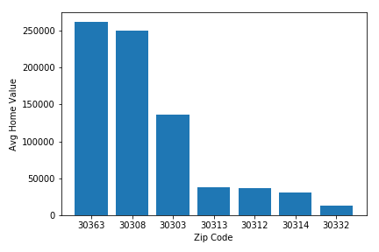
Results from Price
Our data shows zip codes 30363 and 30308 have the highest average home price.

Slide 20
Data Correlation Results

Slide 21
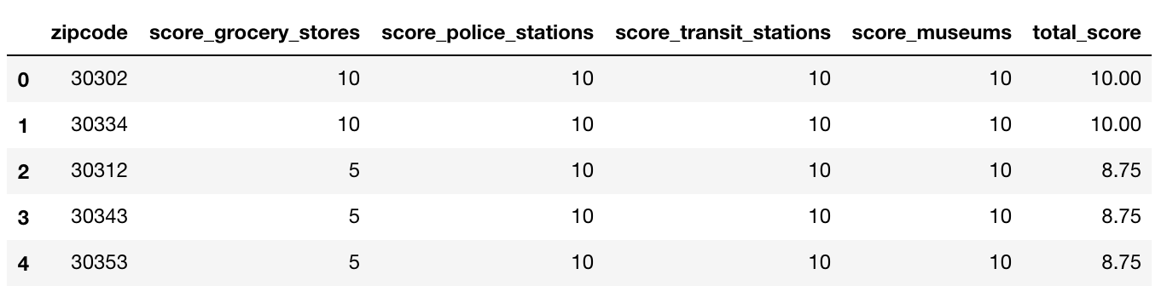
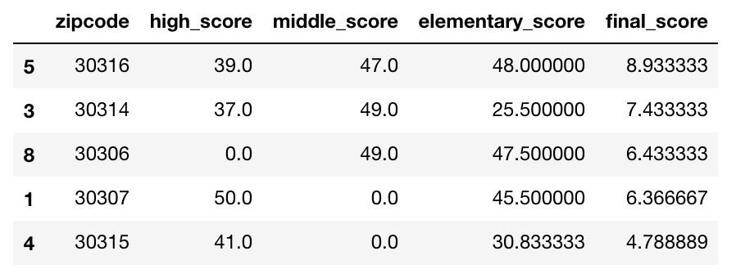
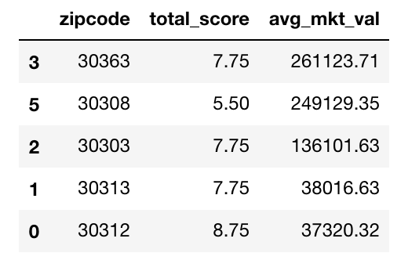
Results from Neighborhood, Schools

Slide 22
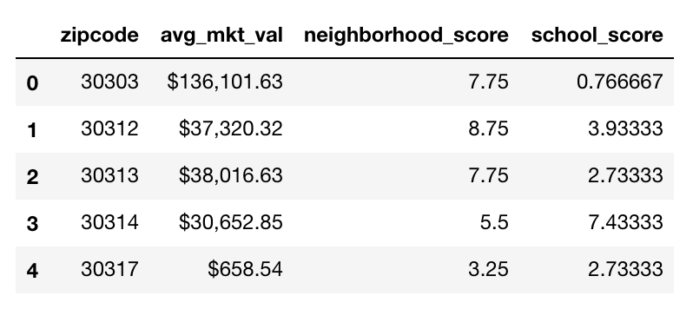
Results from Price, Neighborhood and Schools

Slide 23
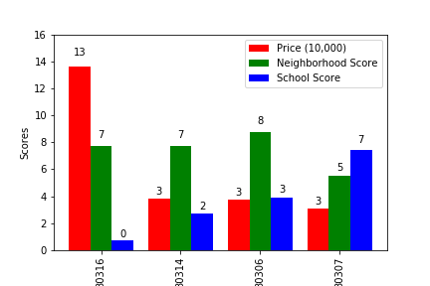
Overall Results
Our results that the best zip code to live in for schools is 30307 and the best zip code to live in for neighborhood is 30306.
The priciest zip code did not have the highest school or neighborhood score. However, this zip code is in an industrialized / business area. There are not a lot of schools in this district.

Slide 24

Best of Everything
Zip Code | Market Value | Neighborhood | School | Final
30314 | 30652.85 | 5.5 | 7.433333 | 12.933333
30312 | 37320.32 | 8.75 | 3.933333 | 12.683333
30313 | 38016.63 | 7.75 | 2.733333 | 10.483333
30303 | 136101.63 | 7.75 | 0.766667 | 8.516667
The Best Overall Zip Code is 30314!!

Slide 25
Conclusion / Takeaway Observations
Based on our data, our Hypotheses was proven to an extent. The school ratings were less where house prices were very low. However, we could not find a correlation between prices and good (high ranking) neighborhood.
The best part of the application is the user gets to choose where they want to use based on best schools, best neighborhoods, best price and combination of all three criteria.

Slide 26
Post Mortem
If we had more API calls, we would have looked at a wider radius
We would have implemented pagination to capture more data
If we had more time, we would show our data frame with all of the functions it has (search by zip code, address, etc.)

